Slide 1

Perspectives and Outlook on
Network Embedding and GCN
Peng Cui
Tsinghua University

Slide 2
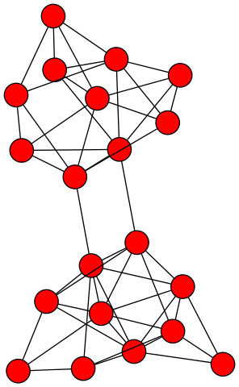
Network (Graph)
The general description of data and their relations.

Slide 3
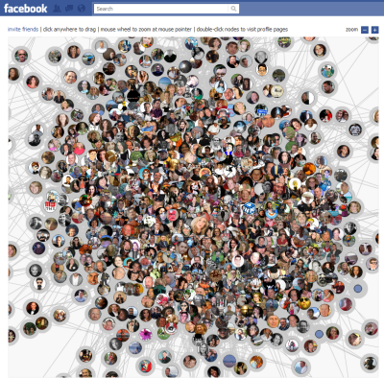
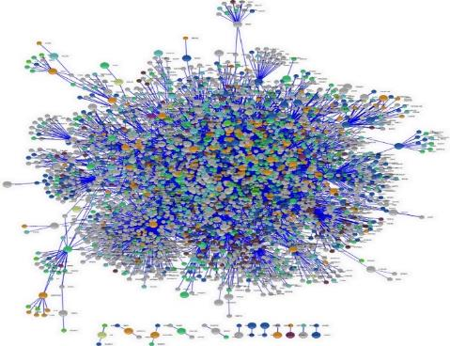
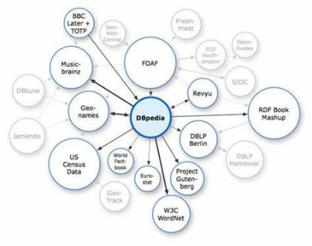

Many types of data are networks
Social Networks
Biology Networks
Finance Networks
Internet of Things
Information Networks
Logistic Networks
Notes:
左，右图更新
challenge

Slide 4
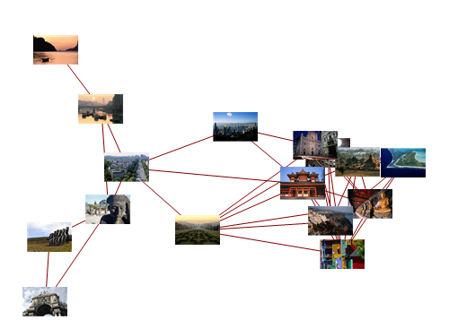
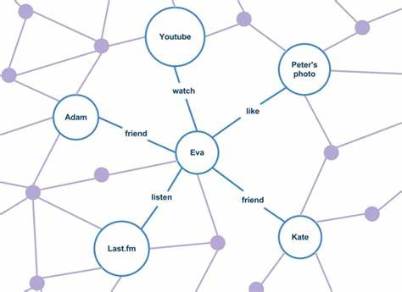
Why network is important?
In few cases, you only care about a subject but not its relations with other subjects.
Image Characterization
Social Capital
Target
Target
Reflected by relational subjects
Decided by relational subjects
Notes:
左，右图更新
challenge

Slide 5
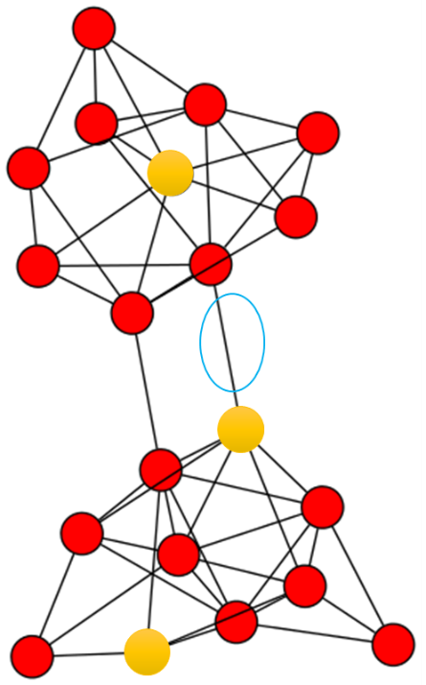
Networks are not learning-friendly
Pipeline for network analysis
G = ( V, E )
Network
Data
Inapplicability of ML methods
Feature Extraction
Links
Topology
Learnability
Pattern Discovery
Network Applications

Slide 6
Learning from networks
Network Embedding
GCN

Slide 7
Network Embedding
G = ( V, E )
G = ( V )
Vector Space
generate
embed
  Easy to parallel
  Can apply classical ML methods

Slide 8
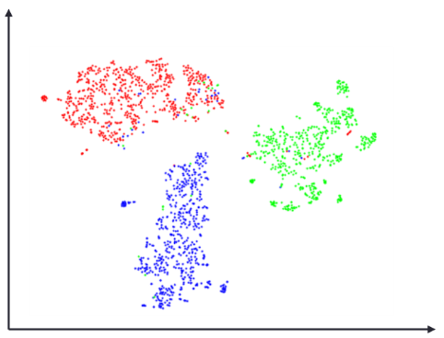
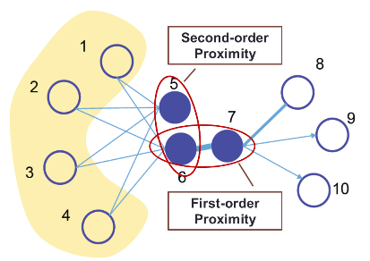
The goal of network embedding
Goal Support network inference in vector space
Reflect network structure
Maintain network properties
B
A
C
Transitivity
Transform network nodes into vectors that are fit for
off-the-shelf machine learning models.
Notes:
分2页，1.0和2.0的区别

Slide 9
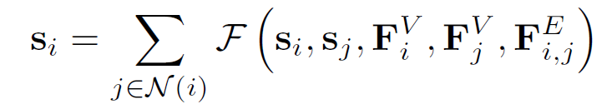
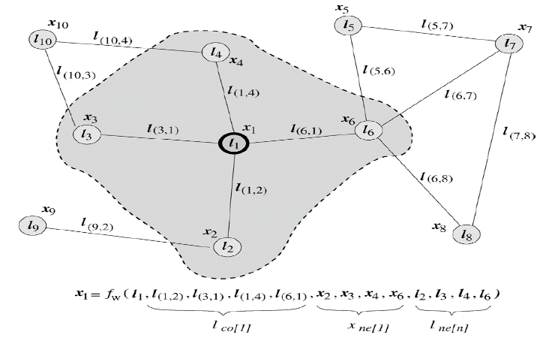
Graph Neural Networks
Design a learning mechanism on graph.
Basic idea: recursive definition of states
A simple example: PageRank
F. Scarselli, et al. The graph neural network model. IEEE TNN, 2009.

Slide 10

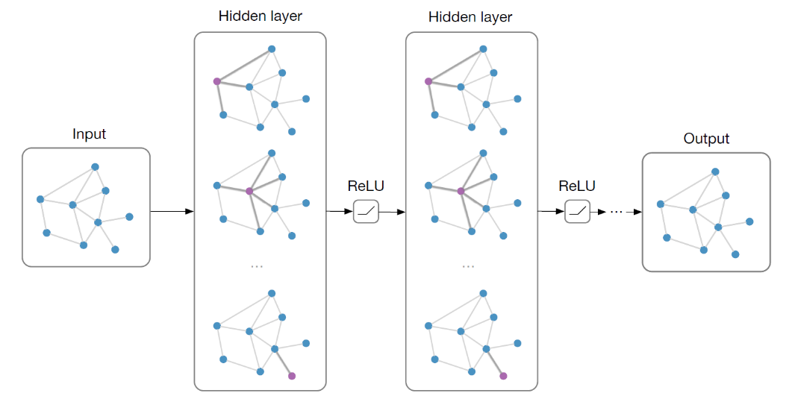
Graph Convolutional Networks (GCN)
Main idea: pass messages between pairs of nodes & agglomerate
Stacking multiple layers like standard CNNs:
  State-of-the-art results on node classification
T. N. Kipf and M. Welling. Semi-supervised classification with graph convolutional networks. ICLR, 2017.

Slide 11
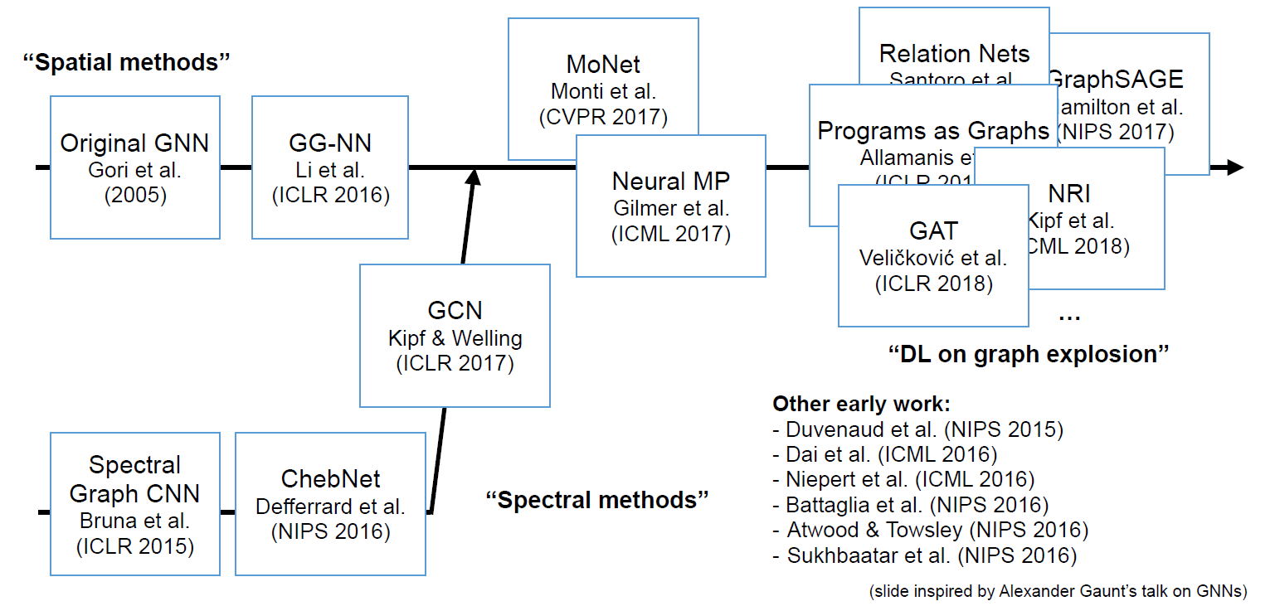
A brief history of GNNs

Slide 12

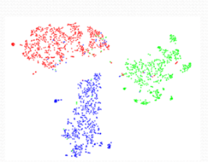

Network Embedding and GCN
Input
Model
Output
Feature
Network Embedding
Task results
Graph
Topology to Vector
Embedding
GCN
Feature
Task results
Fusion of Topology and Features
Unsupervised v.s. (Semi-)Supervised
Notes:
Embedding 得到表征后可能与feature拼起来做后续任务，所以上面画了个虚线feature加进来(是否合理？？)

Slide 13
Graph convolutional network v.s. Network embedding
In some sense, they are different.
Graphs exist in mathematics. (Data Structure)
  Mathematical structures used to model pairwise relations between objects
Networks exist in the real world. (Data)
  Social networks, logistic networks, biology networks, transaction networks, etc.
A network can be represented by a graph.
A dataset that is not a network can also be represented by a graph.

Slide 14
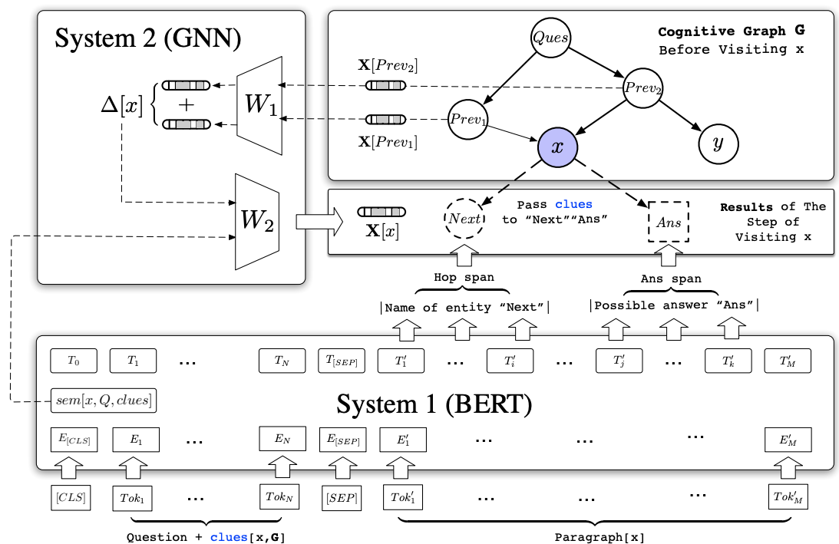
GCN for Natural Language Processing
Many papers on BERT + GNN.
BERT is for retrieval.
  It creates an initial graph of relevant entities and the initial evidence.
GNN is for reasoning.
  It collects evidence (i.e., old messages on the entities) and arrive at new conclusions (i.e., new messages on the entities), by passing the messages around and aggregating them.
  Cognitive Graph for Multi-Hop Reading Comprehension at Scale. Ding et al., ACL 2019.
  Dynamically Fused Graph Network for Multi-hop Reasoning. Xiao et al., ACL 2019.

Slide 15
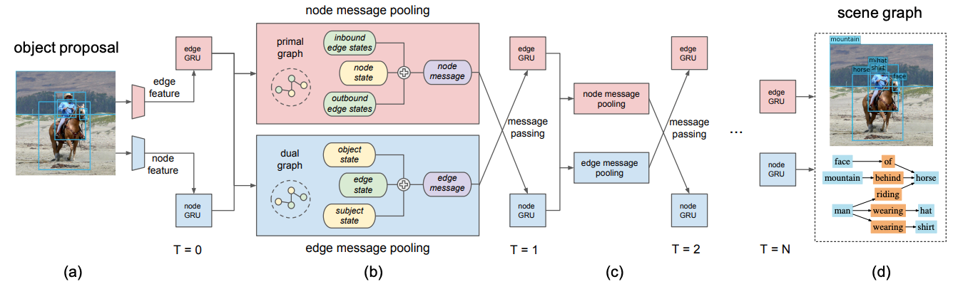
GCN for Computer Vision
A popular trend in CV is to construct a graph during the learning process.
  To process multiple objects or parts in a scene, and to infer their relationships.
Example: Scene graphs.
  Scene Graph Generation by Iterative Message Passing. Xu et al., CVPR 2017.
  Image Generation from Scene Graphs. Johnson et al., CVPR 2018.

Slide 16
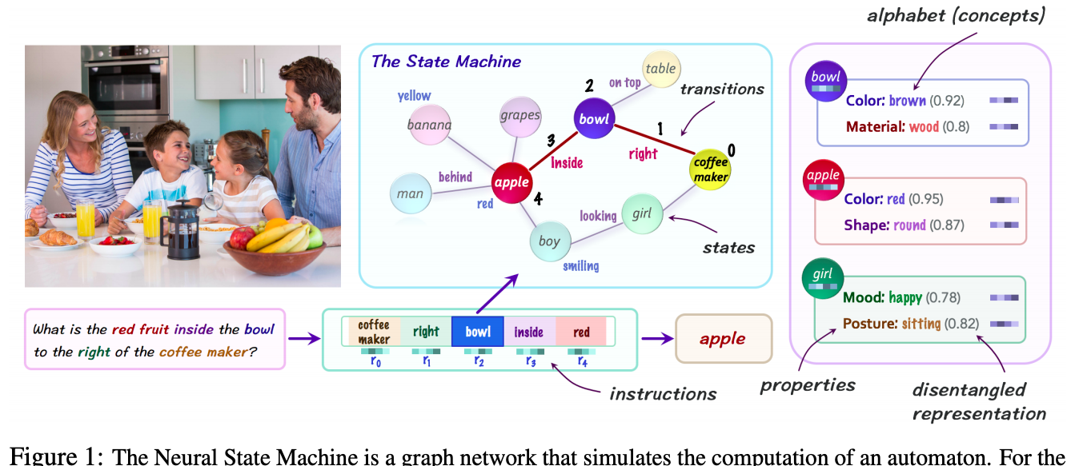
GCN for Symbolic Reasoning
We can view the process of symbolic reasoning as a directed acyclic graph.
Many recent efforts use GNNs to perform symbolic reasoning.
  Learning by Abstraction: The Neural State Machine. Hudson & Manning, 2019.
  Can Graph Neural Networks Help Logic Reasoning? Zhang et al., 2019.
  Symbolic Graph Reasoning Meets Convolutions. Liang et al., NeurIPS 2018.

Slide 17
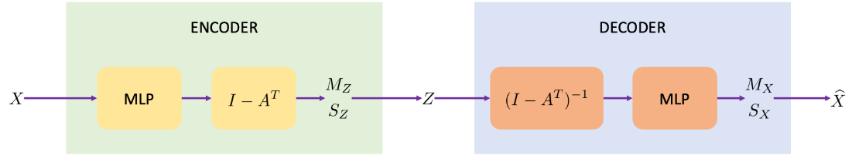
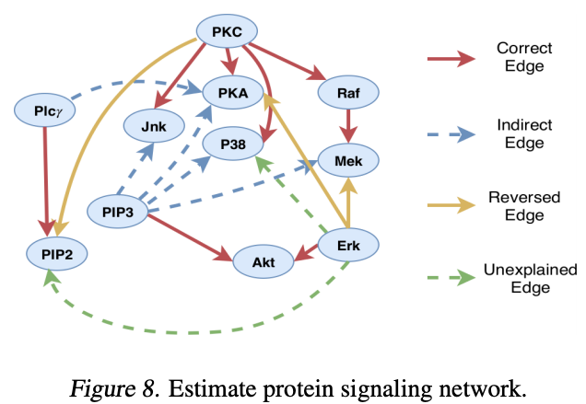
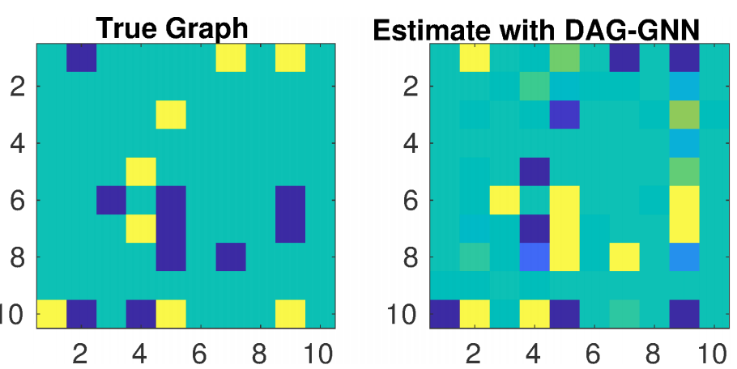
GCN for Structural Equation Modeling
Structural equation modeling, a form of causal modeling, tries to describe the relationships between the variables as a directed acyclic graph (DAG).
GNN can be used to represent a nonlinear structural equation and help find the DAG, after treating the adjacency matrix as parameters.
  DAG-GNN: DAG Structure Learning with Graph Neural Networks. Yu et al., ICML 2019.

Slide 18
Pipeline for (most) GCN works
Graph Construction
GCN
Raw Data
End task

Slide 19
Network embedding: topology to vector
Co-occurrence (neighborhood)

Slide 20
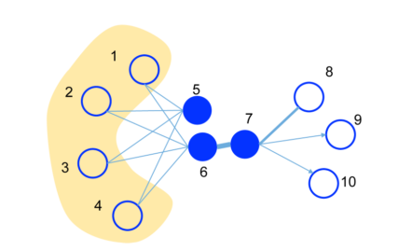
Network embedding: topology to vector
High-order proximities

Slide 21
Network embedding: topology to vector
Communities

Slide 22
Network embedding: topology to vector
Heterogeneous networks

Slide 23
Pipeline for (most) Network Embedding works
Network Embedding
Downstream Model
Network Data
End task

Slide 24
Learning for Networks vs. Learning via Graphs
Learning Via Graphs
GCN
Network Embedding
Learning for networks

Slide 25
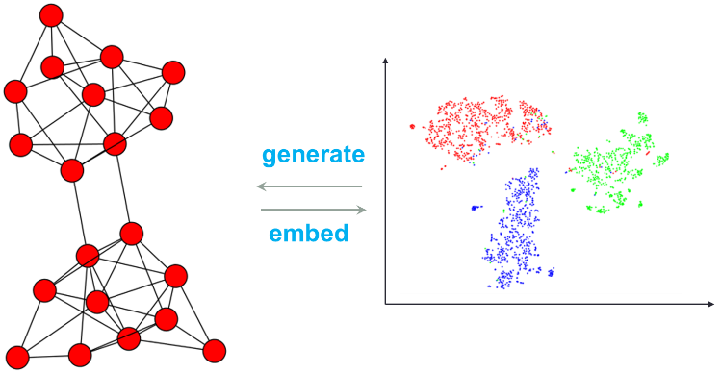
The intrinsic problems NE is solving
Reducing representation dimensionality while preserving necessary topological structures and properties.
Nodes & Links
Non-transitivity
Node Neighborhood
Asymmetric Transitivity
Pair-wise Proximity
Topology-driven
Uncertainty
Community
Dynamic
Hyper Edges
Heterogeneity
Global Structure
Interpretability
Notes:
Embedding 得到表征后可能与feature拼起来做后续任务，所以上面画了个虚线feature加进来(是否合理？？)

Slide 26



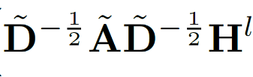
The intrinsic problem GCN is solving
Fusing topology and features in the way of smoothing features with the assistance of topology.
N
d
d
Feature-driven
N
N
N
X
=
Notes:
Embedding 得到表征后可能与feature拼起来做后续任务，所以上面画了个虚线feature加进来(是否合理？？)

Slide 27
What if the problem is topology-driven?
Since GCN is filtering features, it is inevitably feature-driven
  Structure only provides auxiliary information (e.g. for filtering/smoothing)
When feature plays the key role, GNN performs good …
How about the contrary?
Synthesis data: stochastic block model + random features
Method | Results
Random | 10.0
GCN | 18.3±1.1
DeepWalk | 99.0±0.1

Slide 28
Network Embedding v.s. GCN
There is no better one, but there is more proper one.
Network Embedding
GCN
Feature-based Learning
Node
Features
Topology

Slide 29
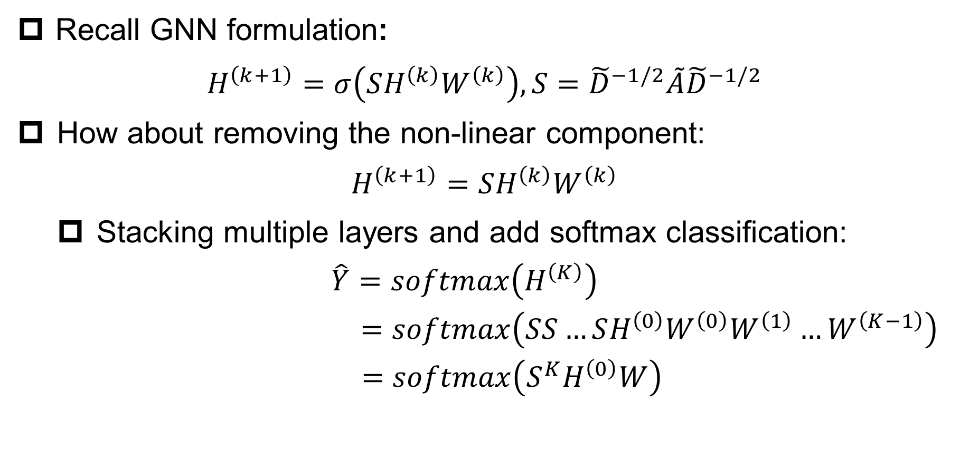
Rethinking: Is GCN truly a Deep Learning method?
Recall GNN formulation:
$$H^{\left(k+1\right)}=σ\left(SH^{\left(k\right)}W^{\left(k\right)}\right),S={\tilde{D}}^{−1/2}\tilde{A}{\tilde{D}}^{−1/2}$$
How about removing the non-linear component:
$$H^{\left(k+1\right)}=SH^{\left(k\right)}W^{\left(k\right)}$$
  Stacking multiple layers and add softmax classification:
  $$\hat{Y}=softmax\left(H^{\left(K\right)}\right)$$
  $$=softmax\left(SS…SH^{\left(0\right)}W^{\left(0\right)}W^{\left(1\right)}…W^{\left(K−1\right)}\right)$$
  $$=softmax\left(S^{K}H^{\left(0\right)}W\right)$$
High-order proximity
Wu, Felix, et al. Simplifying graph convolutional networks. ICML, 2019.

Slide 30
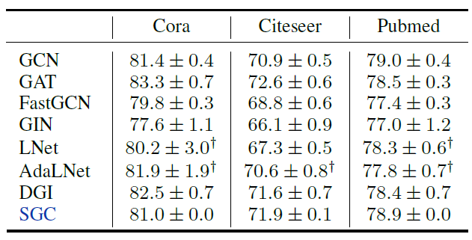
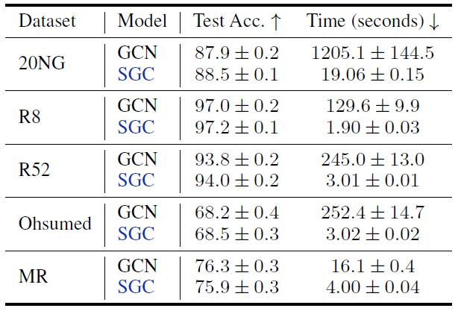
Rethinking: Is GCN truly a Deep Learning method?
This simplified GNN (SGC) shows remarkable results:
  Node classification Text Classification
Wu, Felix, et al. Simplifying graph convolutional networks. ICML, 2019.

Slide 31
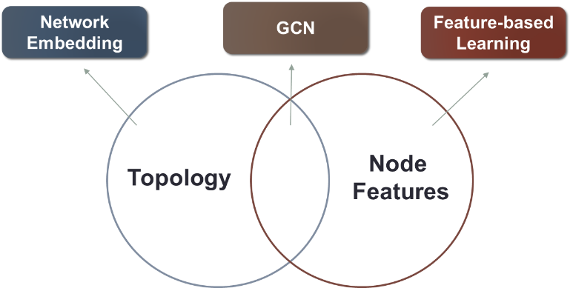
Summaries and Conclusions
Unsupervised v.s. (Semi-)Supervised
Learning for Networks v.s. Learning via Graphs
Topology-driven v.s. Feature-driven
Both GCN and NE need to treat the counterpart as the baselines

Slide 32

Thanks!
Peng Cui
cuip@tsinghua.edu.cn
http://pengcui.thumedialab.com

